Slide 1
IT 356: Introduction To Computer Graphics (Lecture 10)
School of Information Technology
Illinois State University
Dr. Qi Zhang, Spring 2024

Slide 2
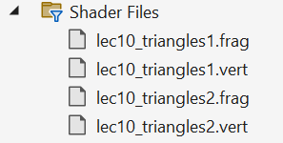
Two Pairs of Shaders

Slide 3
lec10_triangles1.vert
#version 460 core
layout( location = 0 ) in vec3 vPosition;
void main()
{
gl_Position = vec4(vPosition, 1.0);
}

Slide 4
lec10_triangles1.frag
#version 460 core
out vec4 FragColor;
void main()
{
FragColor = vec4(0.1, 0.4, 0.8, 1.0);
}

Slide 5
lec10_triangles2.vert
#version 460 core
layout( location = 0 ) in vec3 vPosition;
void main()
{
gl_Position = vec4(vPosition, 1.0);
}

Slide 6
lec10_triangles2.frag
#version 460 core
out vec4 FragColor;
void main()
{
FragColor = vec4(0.0, 0.4, 0.8, 1.0);
}

Slide 7
Two Shader Program IDs
//Shader Program (shaderProgram)'s ID
unsigned int shaderProgram1;
unsigned int shaderProgram2;
//Return shaderProgram, which is used to set the shader program's ID
//i.e., shaderProgram1 and shaderProgram2
shaderProgram1 = loadShader("../../src/shader/lec10_triangles1.vert",
"../../src/shader/lec10_triangles1.frag");
shaderProgram2 = loadShader("../../src/shader/lec10_triangles2.vert",
"../../src/shader/lec10_triangles2.frag");

Slide 8
Two VBOs and Two VAOs
//Vertex Buffer Object (VBO)
unsigned int VBOs[2];
//Vertex Array Object (VAO)
unsigned int VAOs[2];
//We can generate multiple VAOs and VBOs at the same time
glGenVertexArrays(2, VAOs);
glGenBuffers(2, VBOs);

Slide 9
Two Triangles
//Set up vertex data (and buffer(s)) and configure vertex attributes
float firstTriangle[] = {
-0.90f, -0.90f, 0.0f,
0.90f, -0.90f, 0.0f,
-0.90f, 0.90f, 0.0f,
};
float secondTriangle[] = {
0.90f, -0.90f, 0.0f,
0.90f, 0.90f, 0.0f,
-0.90f, 0.90f, 0.0f,
};

Slide 10
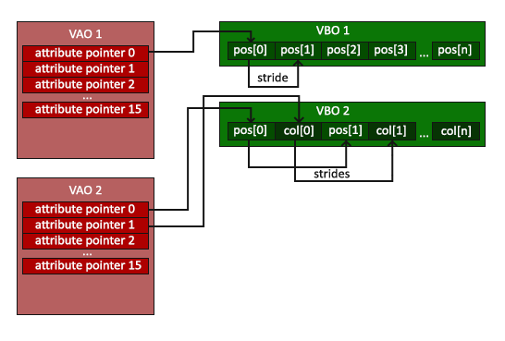
The First Triangle Setup
//First triangle setup
glBindVertexArray(VAOs[0]);
glBindBuffer(GL_ARRAY_BUFFER, VBOs[0]);
glBufferData(GL_ARRAY_BUFFER, sizeof(firstTriangle), firstTriangle, GL_STATIC_DRAW);
//Vertex attributes stay the same
glVertexAttribPointer(0, 3, GL_FLOAT, GL_FALSE, 3 * sizeof(float), (void*)0);
glEnableVertexAttribArray(0);

Slide 11
The Second Triangle Setup
//The Second triangle setup
glBindVertexArray(VAOs[1]);//Note that we bind to a different VAO now
glBindBuffer(GL_ARRAY_BUFFER, VBOs[1]);//And a different VBO
glBufferData(GL_ARRAY_BUFFER, sizeof(secondTriangle), secondTriangle, GL_STATIC_DRAW);
//Because the vertex data is tightly packed
glVertexAttribPointer(0, 3, GL_FLOAT, GL_FALSE, 3 * sizeof(float), (void*)0);
glEnableVertexAttribArray(0);

Slide 12
Draw The First Triangle
//When we draw the triangle, we first use the vertex and fragment //shader from the first program
glUseProgram(shaderProgram1);
//Draw the first triangle using the data from our first VAO
glBindVertexArray(VAOs[0]);
//This call should output the first triangle
glDrawArrays(GL_TRIANGLES, 0, 3);

Slide 13
Draw The Second Triangle
//Then we draw the second triangle using the data from
//the second VAO.
//When we draw the second triangle, we want to use a different //shader program, so we switch to the second shader program.
glUseProgram(shaderProgram2);
glBindVertexArray(VAOs[1]);
//This call should output the second triangle
glDrawArrays(GL_TRIANGLES, 0, 3);
//No need to unbind it every time
glBindVertexArray(0);

Slide 14
Release Resources
//Deallocate all resources by deleting VAO and VBO objects
//Optional: de-allocate all resources once they've outlived their purpose:
glDeleteVertexArrays(1, &VAO);
glDeleteBuffers(1, &VBO);
//Deallocate all resources by deleting VAO and VBO objects
//Optional: de-allocate all resources once they've outlived their purpose:
glDeleteVertexArrays(2, VAOs);
glDeleteBuffers(2, VBOs);

Slide 15
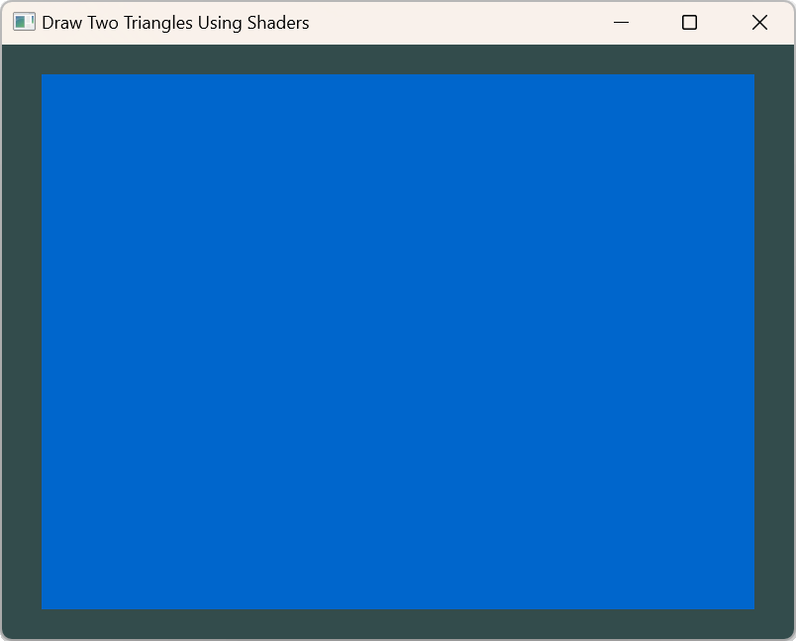
Result

Slide 16
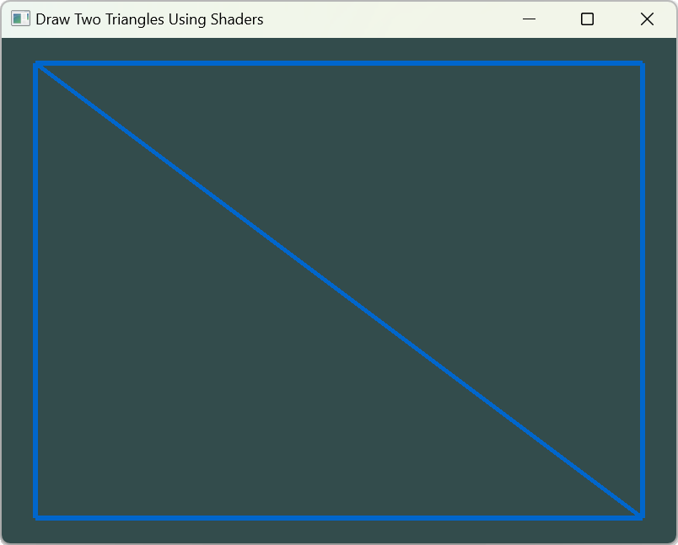
Wireframe Polygons
//Wireframe polygons.
glLineWidth(6);
glPolygonMode(GL_FRONT_AND_BACK, GL_LINE);

Slide 17
Update lec10_triangles1.frag
#version 460 core
out vec4 FragColor;
uniform float timeVal;
void main()
{
FragColor = vec4(abs(sin(timeVal)), 0.4, 0.8, 1.0);
}

Slide 18
Variables for Shader Adjustment
//Variables for shader adjustment
GLint nChangeCol;
float timeValue;
//Initialize variables for shader adjustment
nChangeCol = 1;

Slide 19
Variables Used to Update Shader Uniform
//Variable used to update shader uniform
timeValue = 0.0f;
if (nChangeCol == 0) {
timeValue = glfwGetTime();
}
else if (nChangeCol == 1) {
timeValue = 0.0f;
}
//Transfer data to shader
int timeLoc = glGetUniformLocation(shaderProgram1, "timeVal");
glUniform1f(timeLoc, timeValue);

Slide 20
The glGetUniformLocation Function
GLint glGetUniformLocation( GLuint program, const GLchar *name);
program: Specifies the program object to be queried.
name: Points to a null-terminated string containing the name of the uniform variable whose location is to be queried.
glGetUniformLocation returns an integer that represents the location of a specific uniform variable within a program object.

Slide 21
Process All Input Using GLFW
if (glfwGetKey(window, GLFW_KEY_ESCAPE) == GLFW_PRESS)
{
glfwSetWindowShouldClose(window, true);
}
else if (glfwGetKey(window, GLFW_KEY_A) == GLFW_PRESS)
{
nChangeCol = 0;
}
else if (glfwGetKey(window, GLFW_KEY_B) == GLFW_PRESS)
{
nChangeCol = 1;
}

Slide 22
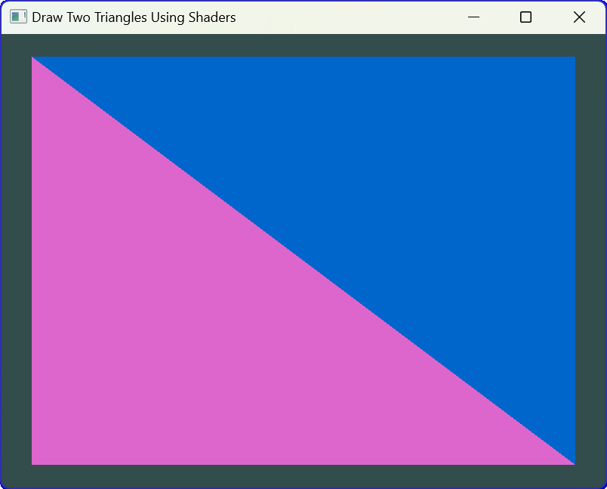
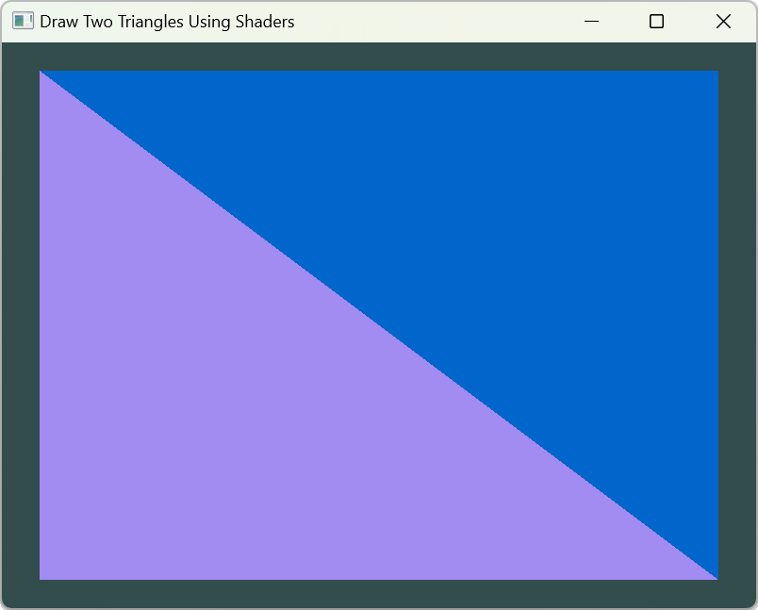
Wireframe Polygons
//Wireframe polygons.
//glLineWidth(6);
//glPolygonMode(GL_FRONT_AND_BACK, GL_LINE);
glPolygonMode(GL_FRONT_AND_BACK, GL_FILL);

Slide 23
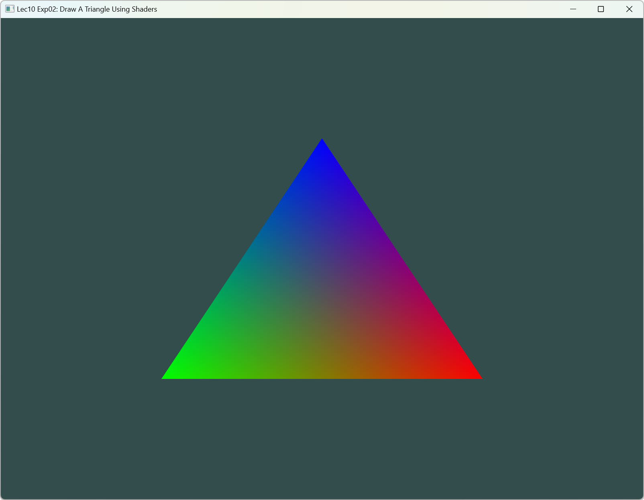
Colored Triangle

Slide 24
VBO and VAO
//Vertex Buffer Object (VBO)
unsigned int VBO;
//Vertex Array Object (VAO)
unsigned int VAO;
//Generate VAO and VBO
glGenVertexArrays(1, &VAO);
glGenBuffers(1, &VBO);

Slide 25
Shader Program
//Shader Program (shaderProgram)'s ID
int shaderProgram;
//Return shaderProgram, which is used to set programID
shaderProgram = loadShader("../../src/shader/lec10_vshader_exp02.glsl",
"../../src/shader/lec10_fshader_exp02.glsl");

Slide 26
Setup Vertex Data
//Set up vertex data (and buffer(s)) and configure vertex attributes
float vertices[] = {
//positions //colors
0.5f, -0.5f, 0.0f, 1.0f, 0.0f, 0.0f, //bottom right
-0.5f, -0.5f, 0.0f, 0.0f, 1.0f, 0.0f, //bottom left
0.0f, 0.5f, 0.0f, 0.0f, 0.0f, 1.0f //top
};

Slide 27
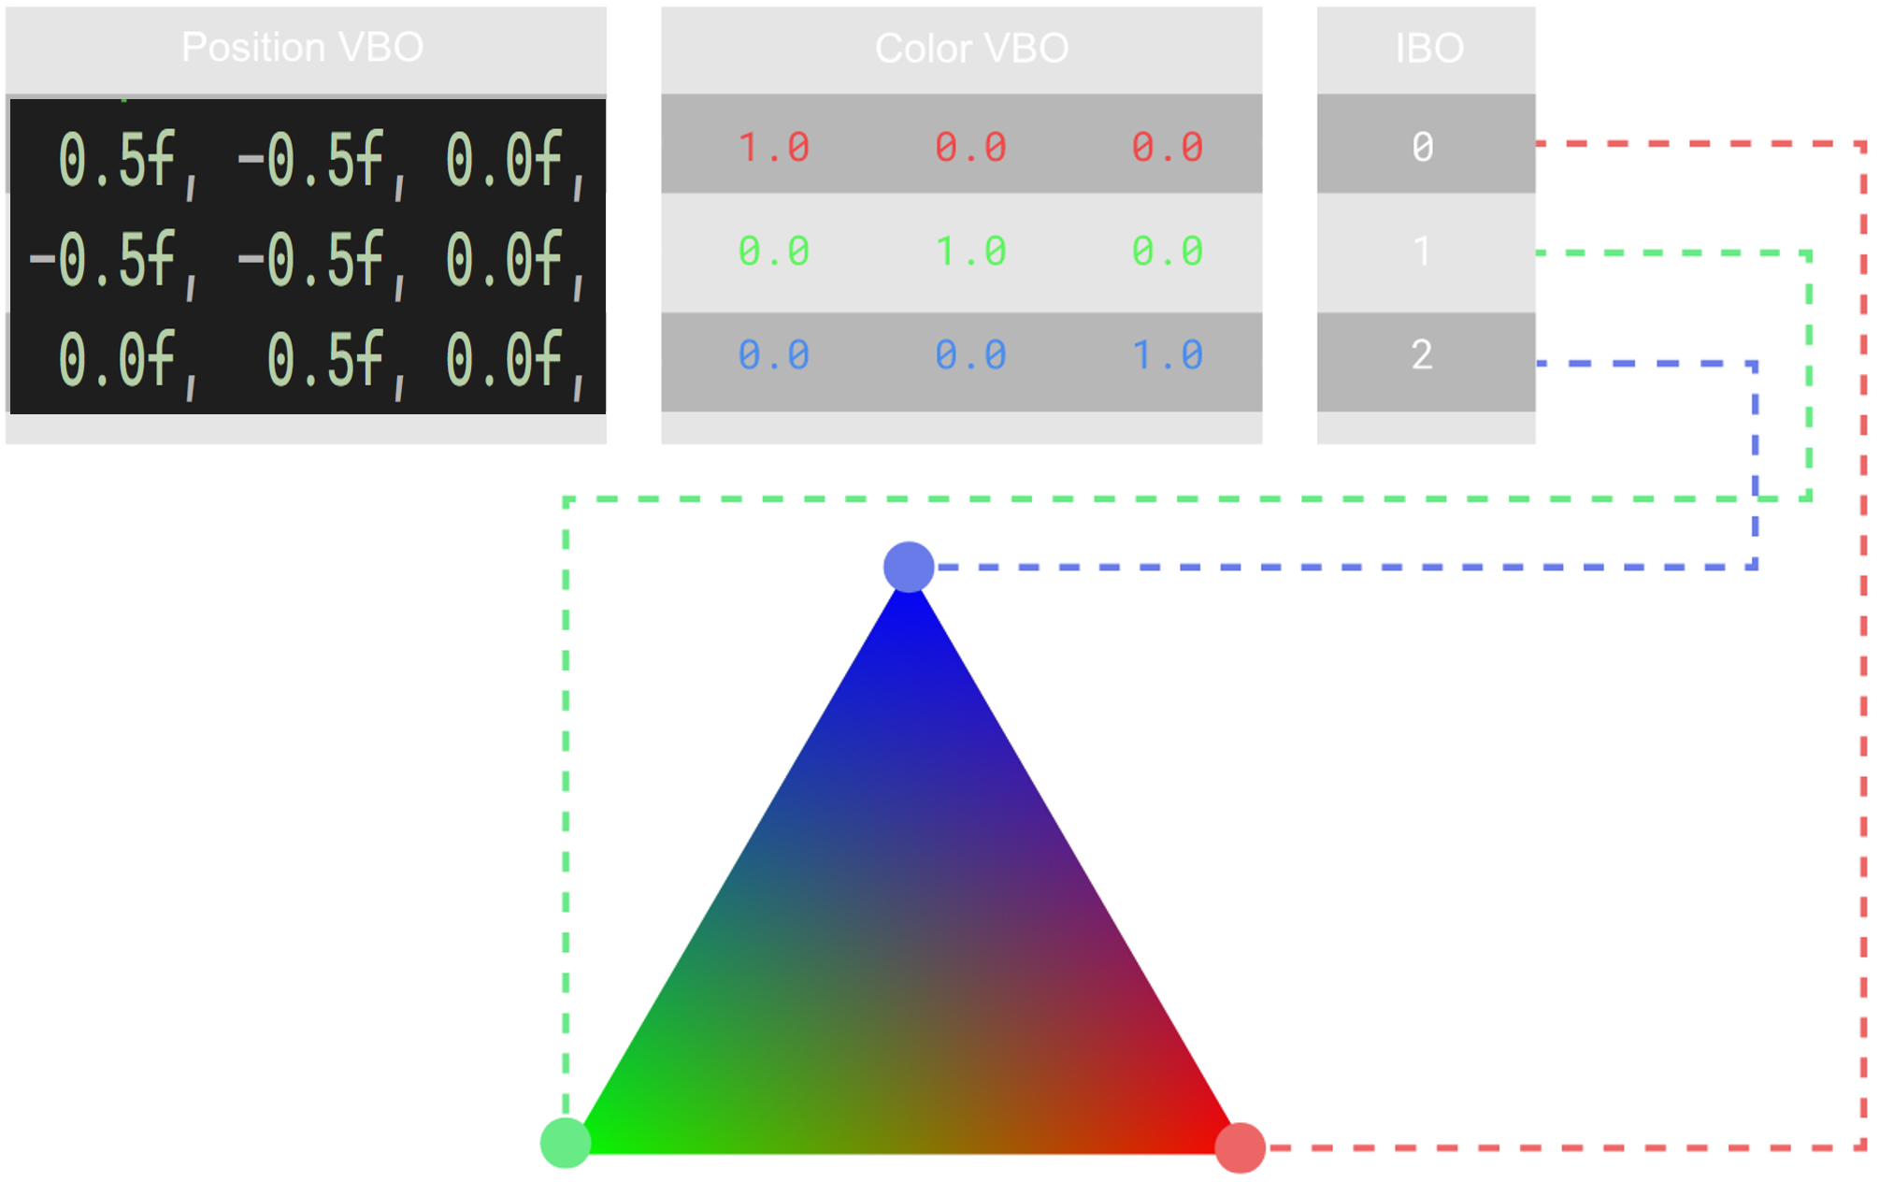
Index Buffer Object (IBO) / Element Buffer Object (EBO)
An Index Buffer Object (IBO) or Element Buffer Object (EBO) is a list of vertex indices that's used to make triangles, lines, or points. When rendering a set of triangles, Index /Element Buffers allow for the reuse of a given vertex for a different triangle.

Slide 28
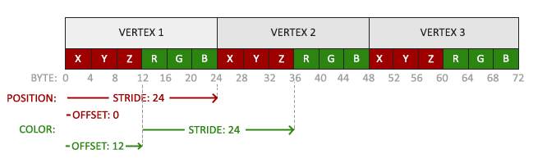
Reconfigure the Vertex Attribute Pointers
Because we added another vertex attribute and updated the VBO's memory
Need to re-configure the vertex attribute pointers. The updated data in the VBO's memory now looks a bit like this:

Slide 29
Bind Vertex Array Object and VBO
//Bind the Vertex Array Object first,
//then bind and set vertex buffer(s), and then configure vertex attributes(s).
glBindVertexArray(VAO);
glBindBuffer(GL_ARRAY_BUFFER, VBO);
glBufferData(GL_ARRAY_BUFFER, sizeof(vertices), vertices, GL_STATIC_DRAW);
//position attribute
glVertexAttribPointer(0, 3, GL_FLOAT, GL_FALSE, 6 * sizeof(float), (void*)0);
glEnableVertexAttribArray(0);
//color attribute
glVertexAttribPointer(1, 3, GL_FLOAT, GL_FALSE, 6 * sizeof(float), (void*)(3 * sizeof(float)));
glEnableVertexAttribArray(1);
Knowing the current layout, we need to update the vertex format with glVertexAttribPointer

Slide 30
More Attributes
We can fill a VBO, configure vertex attribute pointers and store it all in a VAO.

Slide 31
Vertex Shader With Color Variable
We now have more data to send to the vertex shader, it is necessary to adjust the vertex shader to also receive our color value as a vertex attribute input.
Note that we set the location of the aColor attribute to 1 with the layout specifier:
//Set up vertex data (and buffer(s)) and configure vertex attributes
float vertices[] = {
//positions //colors
0.5f, -0.5f, 0.0f, 1.0f, 0.0f, 0.0f, //bottom right
-0.5f, -0.5f, 0.0f, 0.0f, 1.0f, 0.0f, //bottom left
0.0f, 0.5f, 0.0f, 0.0f, 0.0f, 1.0f //top
};

Slide 32
lec10_vshader_exp02.glsl
#version 460 core
//The position variable has attribute position 0
layout (location = 0) in vec3 aPos;
//The color variable has attribute position 1
layout (location = 1) in vec3 aColor;
out vec3 ourColor;
void main()
{
gl_Position = vec4(aPos, 1.0);
//Output a color to the fragment shader
ourColor = aColor;
}
Note that we set the location of the aColor attribute to 1 with the layout specifier

Slide 33
lec10_fshader_exp02.glsl
#version 460 core
out vec4 FragColor;
in vec3 ourColor;
void main()
{
// output a color to the frame buffer
FragColor = vec4(ourColor, 1.0f);
}

Slide 34
Use the Shader Program and GL_FILL
//Use shderProgram
//We only have a single shader
//we could also just activate our shader once beforehand if we want to
glUseProgram(shaderProgram);
//Wireframe polygons.
glPolygonMode(GL_FRONT_AND_BACK, GL_FILL);

Slide 35

Draw the Triangle
//Draw the triangle
glBindVertexArray(VAO);
glDrawArrays(GL_TRIANGLES, 0, 3);

Slide 36
Release Resources
//Deallocate all resources by deleting VAO and VBO objects
//Optional: de-allocate all resources once they've outlived their purpose:
glDeleteVertexArrays(1, &VAO);
glDeleteBuffers(1, &VBO);

Slide 37
Shader Adjust Variables
//Shader adjust variables
//The offset for color changing
float offset_col;
//Initialize shader adjust variables
offset_col = 0.0f;

Slide 38
Update Shader Uniform
//Update shader uniform for color changing from CPU program
int offsetLocation = glGetUniformLocation(shaderProgram, "offset_red");
glUniform1f(offsetLocation, offset_col);

Slide 39
Update lec10_vshader_exp02.glsl
#version 460 core
//The position variable has attribute position 0
layout (location = 0) in vec3 aPos;
//The color variable has attribute position 1
layout (location = 1) in vec3 aColor;
out vec3 ourColor;
uniform float offset_red;
void main()
{
gl_Position = vec4(aPos, 1.0);
//Output a color to the fragment shader
//ourColor = aColor;
ourColor = vec3(aColor.r - offset_red, aColor.g + offset_red, aColor.b);
}
Uniforms can pass data from our application on the CPU to the shaders on the GPU
Uniforms are global, which means that a uniform variable is unique per shader program object and can be accessed from any shader at any stage in the shader program.
Whatever you set the uniform value, uniforms will keep their values until they're either reset or updated.

Slide 40
Uniforms
The uniforms are a useful tool for setting attributes that might change in render iterations
Or for interchanging data between your application and your shaders
Uniform supports many types: float, vec2, vec3, vec4, mat2, mat3, mat4, sampler2D and samplerCube

Slide 41
Update lec10_fshader_exp02.glsl
#version 460 core
out vec4 FragColor;
in vec3 ourColor;
void main()
{
//output a color to the frame buffer
//FragColor = vec4(ourColor, 1.0f);
FragColor = vec4(ourColor.r, ourColor.g, ourColor.b, 1.0f);
}

Slide 42
Process All Input Using GLFW Keys
//Process all input: query GLFW whether relevant keys are pressed/released
//this frame and react accordingly
void processInput(GLFWwindow *window)
{
if (glfwGetKey(window, GLFW_KEY_ESCAPE) == GLFW_PRESS)
{
glfwSetWindowShouldClose(window, true);
}
else if (glfwGetKey(window, GLFW_KEY_R) == GLFW_PRESS)
{
offset_col += 0.01f;
}
else if (glfwGetKey(window, GLFW_KEY_O) == GLFW_PRESS)
{
offset_col = 0.0f;
}
}

Slide 43
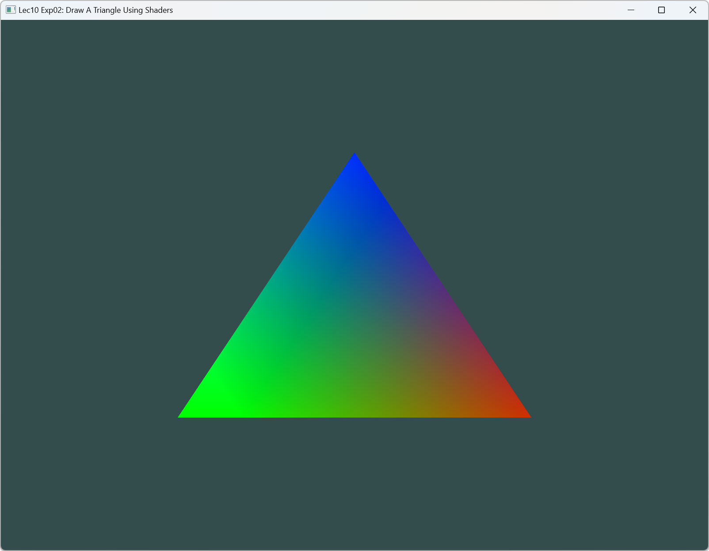
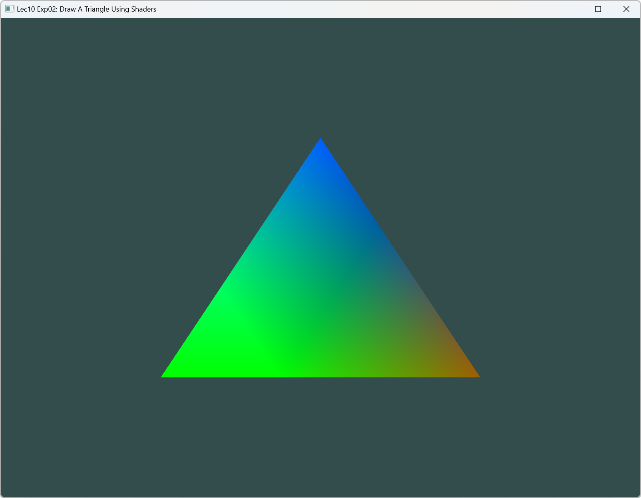
Result
Press “R”/”r” key to change the color, press “O”/”o” key to restore

Slide 44
Change Triangle Position
//The offset for position changing
float offset_pos;
Initialize shader adjust variables
offset_pos = 0.0f;

Slide 45
Update Shader Uniform for Position Change
//Update shader uniform for position changing from CPU program
offsetLocation = glGetUniformLocation(shaderProgram, "offset_pos");
glUniform1f(offsetLocation, offset_pos);

Slide 46
Update lec10_vshader_exp02.glsl
#version 460 core
//The position variable has attribute position 0
layout (location = 0) in vec3 aPos;
//The color variable has attribute position 1
layout (location = 1) in vec3 aColor;
out vec3 ourColor;
uniform float offset_red;
uniform float offset_pos;
void main()
{
//gl_Position = vec4(aPos, 1.0);
gl_Position = vec4(aPos.x, aPos.y - offset_pos, aPos.z, 1.0);
//Output a color to the fragment shader
//ourColor = aColor;
ourColor = vec3(aColor.r - offset_red, aColor.g + offset_red, aColor.b);
}

Slide 47
Add More Input Key from GLFW
else if (glfwGetKey(window, GLFW_KEY_A) == GLFW_PRESS)
{
offset_pos = 0.0f;
}
else if (glfwGetKey(window, GLFW_KEY_B) == GLFW_PRESS)
{
offset_pos += 0.01f;
}
else if (glfwGetKey(window, GLFW_KEY_C) == GLFW_PRESS)
{
offset_pos += -0.01f;
}

Slide 48
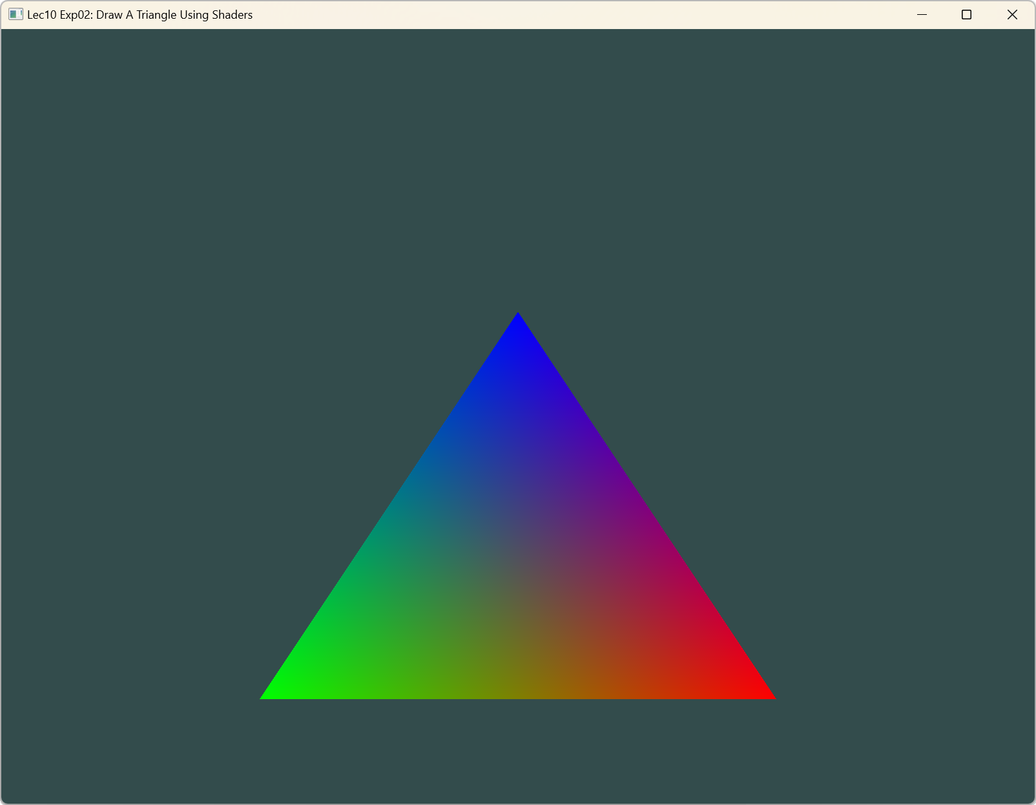
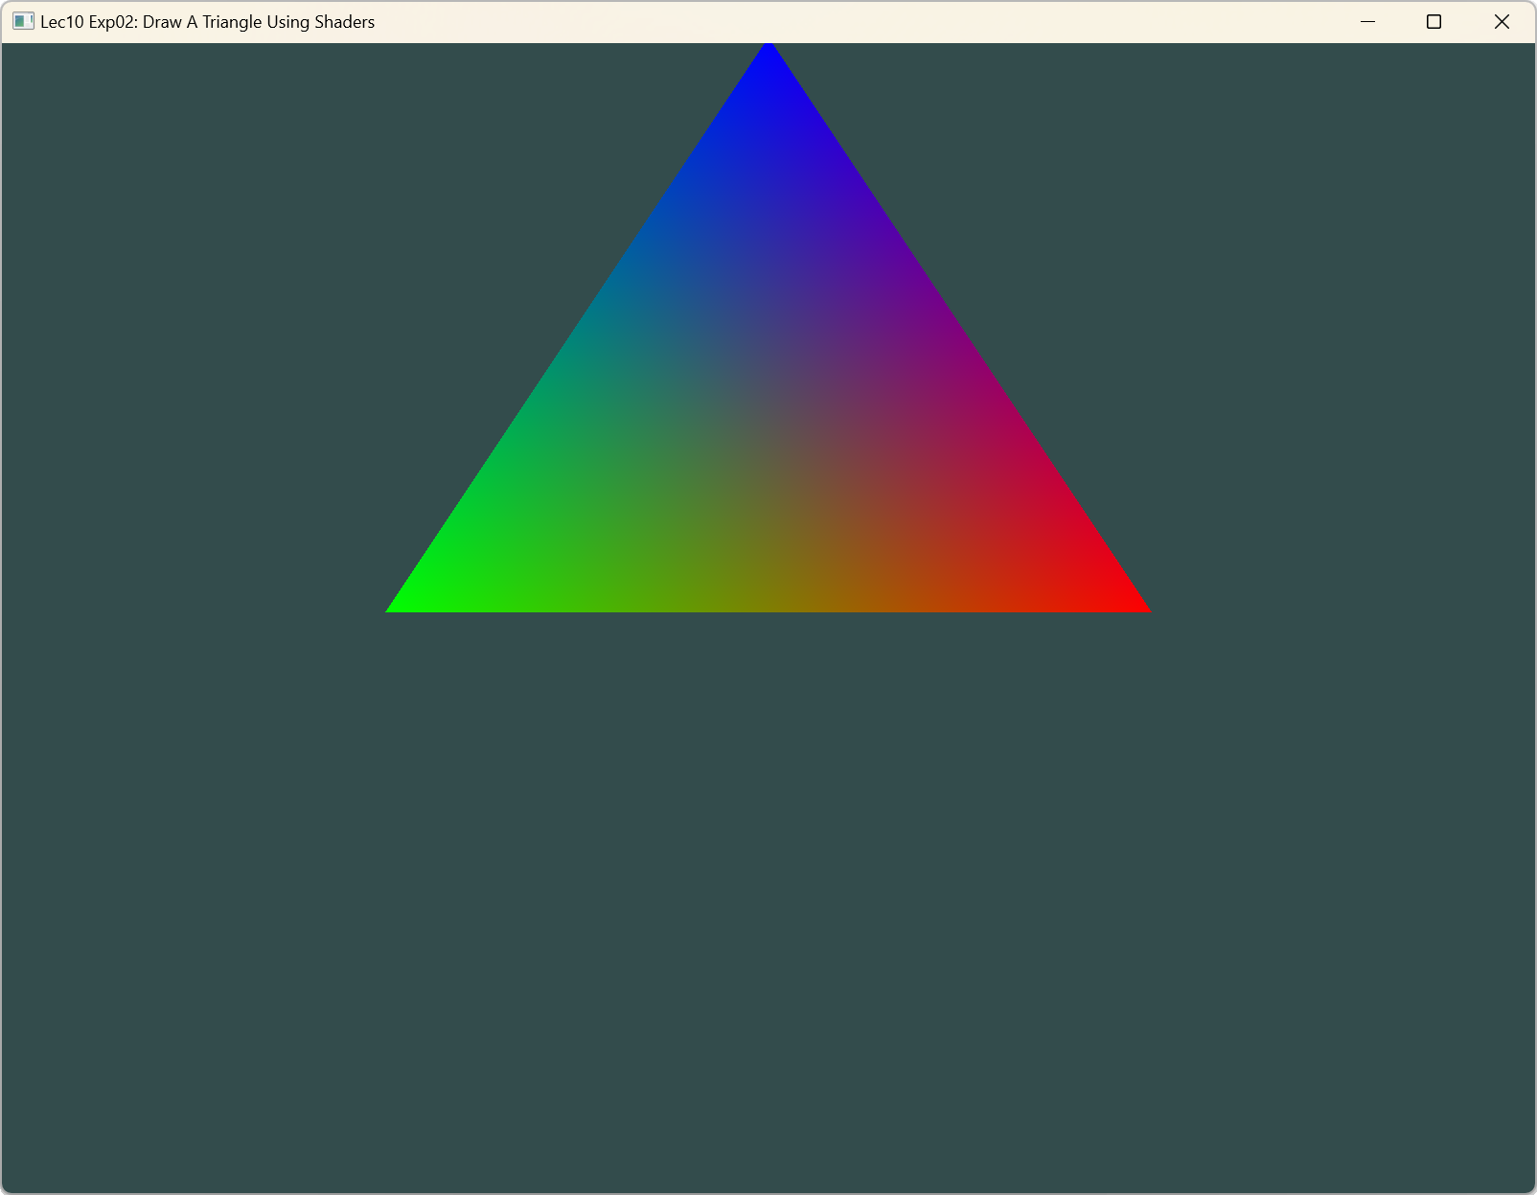
Result
Press key “B”/”b” to move down. Press key “C”/”c” to move up
Press key “A”/”a” to restore initial position

Slide 49
Exercise
Press the “G”/”g” key to enhance blue from the top vertex, and finally the color of the triangle is blue.
Press the “O”/”o” key to restore to the original color.
Press the “B”/”b” key to move the triangle to the right, while press the “C”/”c” key to move the triangle to the left. Press the “A”/”a” key to restore the triangle to the initial position.

